Slide 1
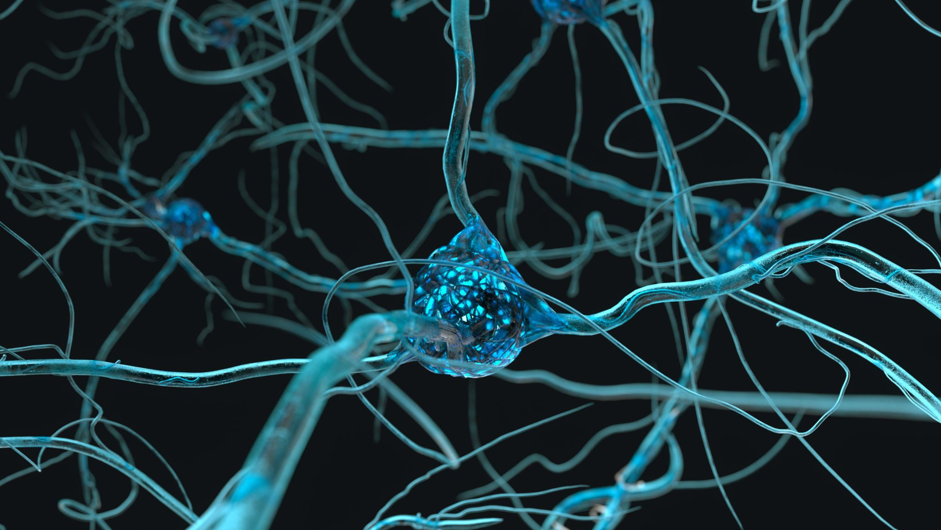
Capsule Neural Networks
Krish Rai

Slide 2

Convolutional Neural Network (Background)
CNNs perform well for computer vision tasks
Image classification
Object detection
3 layers
Convolutional layer: Input data convolved with kernels to extract features like edges, lines, shapes
Pooling: Reduce dimensionality of feature map by subsampling (taking Max or Average)
Fully connected Layer
Fundamental unit: neuron with scalar output

Slide 3
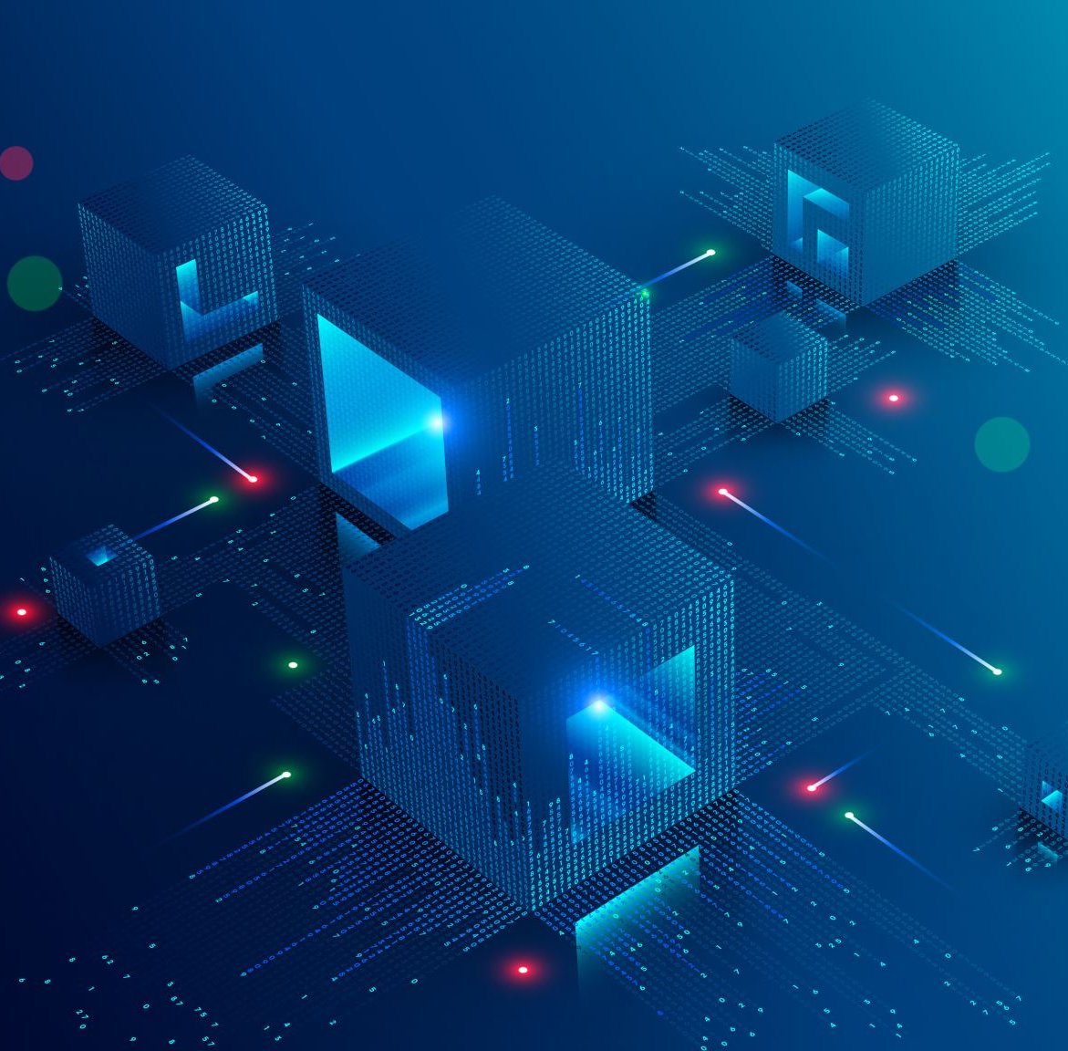
Capsule Network Architecture
Fundamental unit is a capsule: group of neurons
Each capsule provides a vector output unlike a scalar in CNN
Architecture in Capsule
Convolutional layers: extracting features from image input like in CNN

Slide 4
Capsule Network Architecture
Primary Capsule Layer
Feature Processing
Transformation of scalar activation in feature map into vector capsule activations
Vector activation represents feature components (instantiation parameters) such as orientation, skew, thickness, overlap
Fully Connected Layer
CNN: Weights sum of all previous layer outputs
Capsule: Vote for parent capsule using dynamic routing
Iterative process updates weights and refines capsule connections

Slide 5
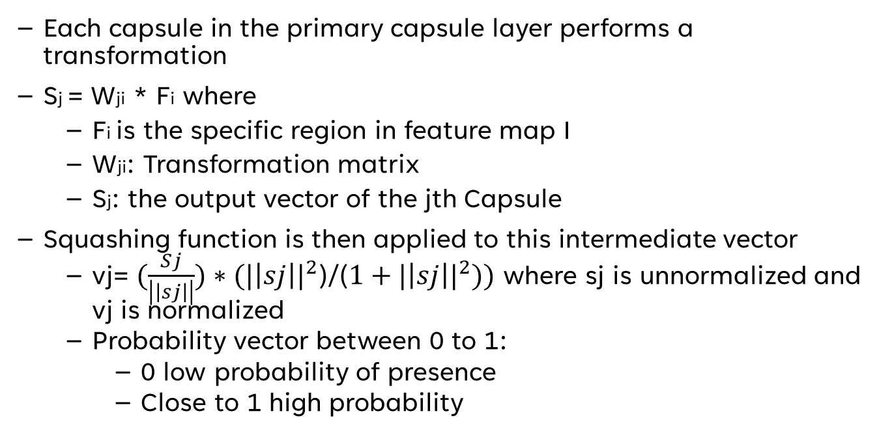
Mathematical Description
Each capsule in the primary capsule layer performs a transformation
Sj = Wji * Fi where
Fi is the specific region in feature map I
Wji: Transformation matrix
Sj: the output vector of the jth Capsule
Squashing function is then applied to this intermediate vector
vj​= ${(\frac{Sj}{\left|\left|sj\right|\right|})∗(|\left|sj\right||}^{2}$)/(${1+|\left|sj\right||}^{2}))$ where sj is unnormalized and vj is normalized
Probability vector between 0 to 1:
0 low probability of presence
Close to 1 high probability

Slide 6
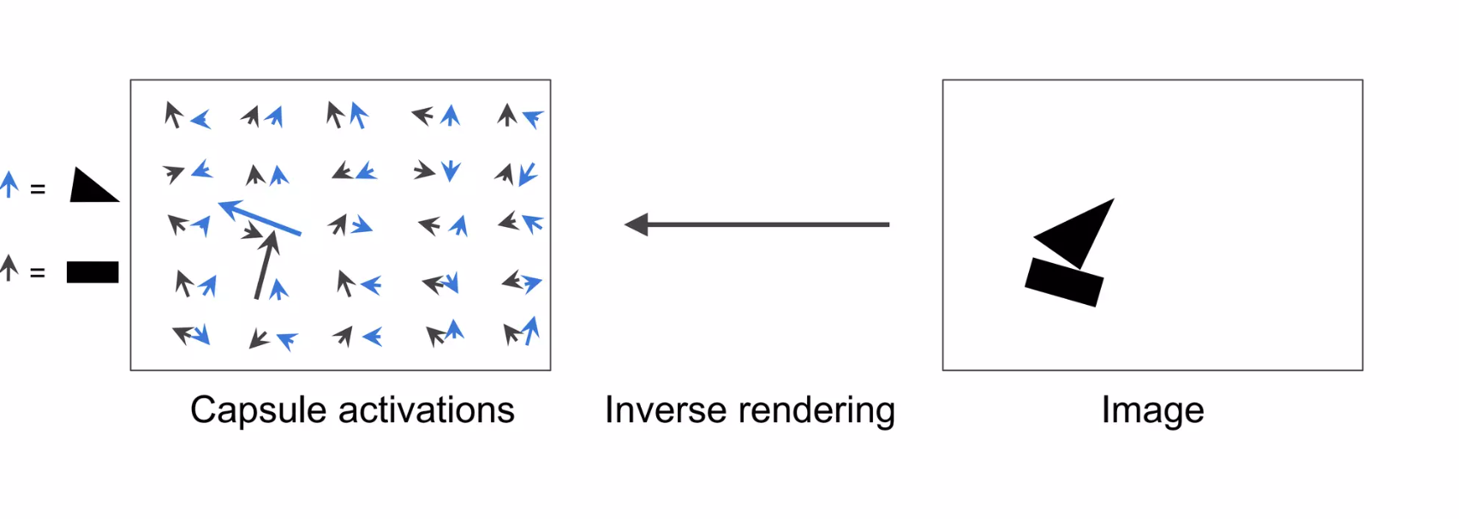
Graphical Depiction
Aurélien Géron, 2017

Slide 7
Routing by Agreement
Routing coefficient – weight of lower layer capsule in higher layer (sums to 1)
Agreement between capsules output and prediction vector
Routing coefficients updated
Grid of vectors with different transformation matrices

Slide 8
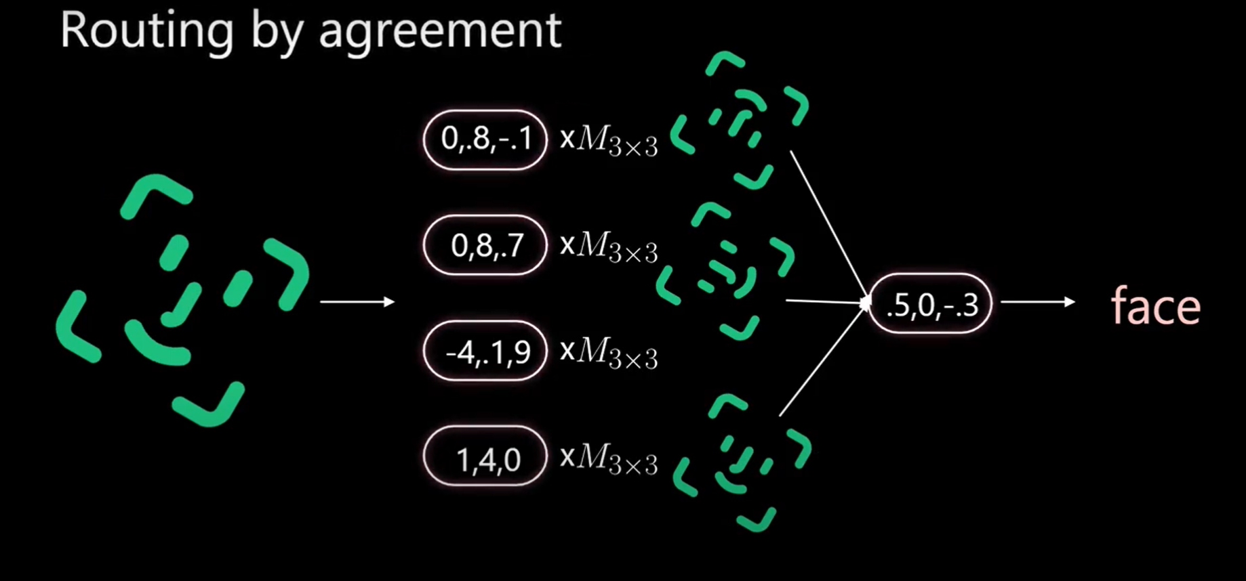
Count from Zero Channel

Slide 9
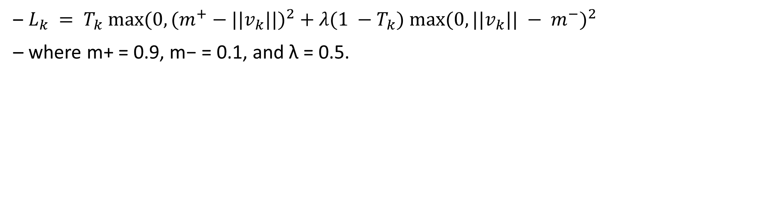
Loss Function
$L_{k} = T_{k} max⁡{(0, {(m}^{+} − ||v_{k}||)}^{2} + λ(1 −T_{k}) {max⁡(0, ||v_{k}|| − m^{−})}^{2}$
where m+ = 0.9, m− = 0.1, and λ = 0.5.

Slide 10
Conclusion
Capsules allow for more specific features like position and overlap to be included in model (equivariance)
Goal: Test this on medical image dataset (ORGANMNIST) and see whether accuracy is comparable to CNN

Slide 11
References
Sabour, Sara, Nicholas Frosst, and Geoffrey E. Hinton. "Dynamic routing between capsules." Advances in neural information processing systems 30 (2017).
Hinton, Geoffrey E., Alex Krizhevsky, and Sida D. Wang. "Transforming auto-encoders." Artificial Neural Networks and Machine Learning–ICANN 2011: 21st International Conference on Artificial Neural Networks, Espoo, Finland, June 14-17, 2011, Proceedings, Part I 21. Springer Berlin Heidelberg, 2011.
Aurélien Géron, 2017: Capsule Networks (CapsNets) – Tutorial (youtube.com). Introduction to Capsule Networks (CapsNets) | PPT (slideshare.net)
Count from Zero:Capsule network explained (youtube.com)

